Slide 1
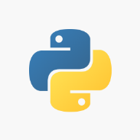
Python for
Data Analytics
Sridhar Palle, Ph.D.

Slide 2
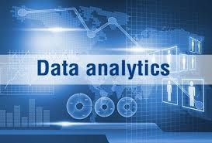
What is Data Analytics?
Interdisciplinary field that employs scientific methods and analytical tools in generating actionable insights from diverse types of data
Visualization, Statistics, Programming
Machine Learning (ML)/Artificial Intelligence
Distributed/Cloud Computing
Information that is implicitly present in the data, (but hitherto unknown value) is discovered
Practical application of AI/ML techniques with a complete focus on solving real-world problems

Slide 3

What is Machine learning?
Machine learning (ML) is the ability of a computer system to learn from the environment and improve itself from experience without the need for any explicit programming.
ML focuses on enabling algorithms to learn from the data provided, by gathering insights and make predictions on previously unseen data

Slide 4
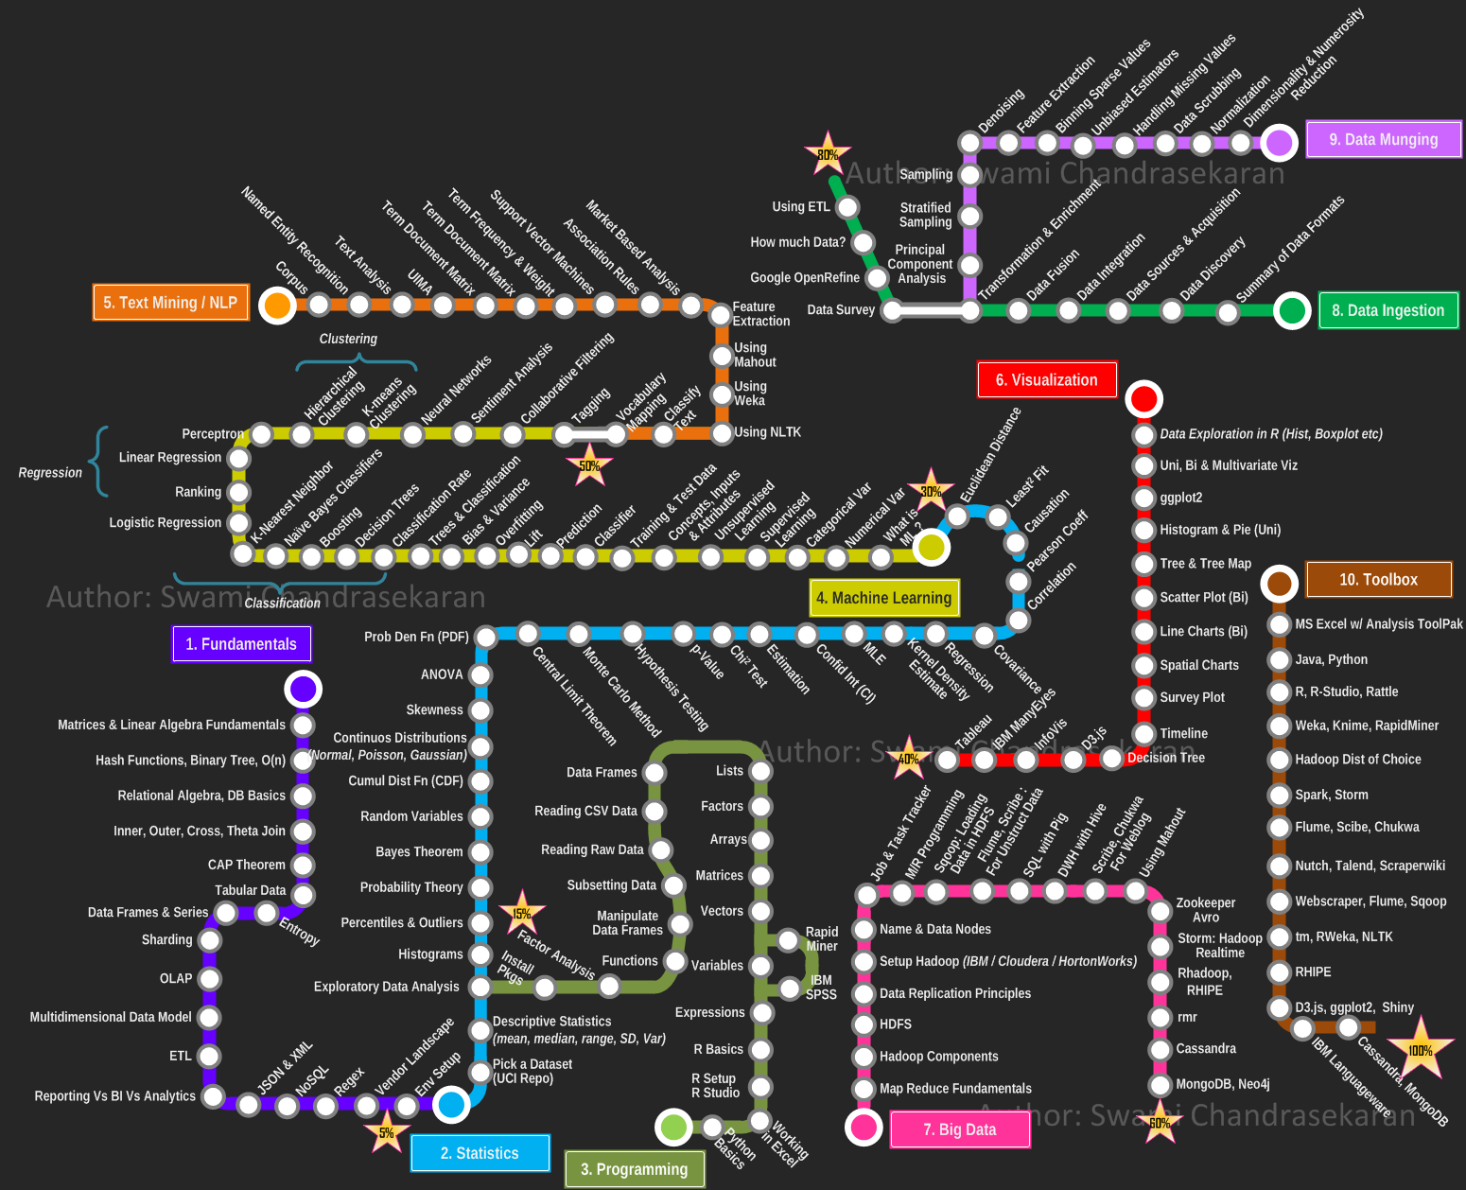
Data analytics Journey Map

Slide 5
Python
Python is a high level programming language for general purpose programming
It is created by Guido Van Rossum in 1991
(He was given the post of BDFL by Python community)
Code readability is emphasized in Python. Simpler, cleaner code.
Zen of Python
Beautiful is better than ugly
Explicit is better than implicit
Simple is better than complex
Complex is better than complicated
Readability counts
Notes:
Several applications: Web applications, scientific computing, gaming, education, data science, software development

Slide 6
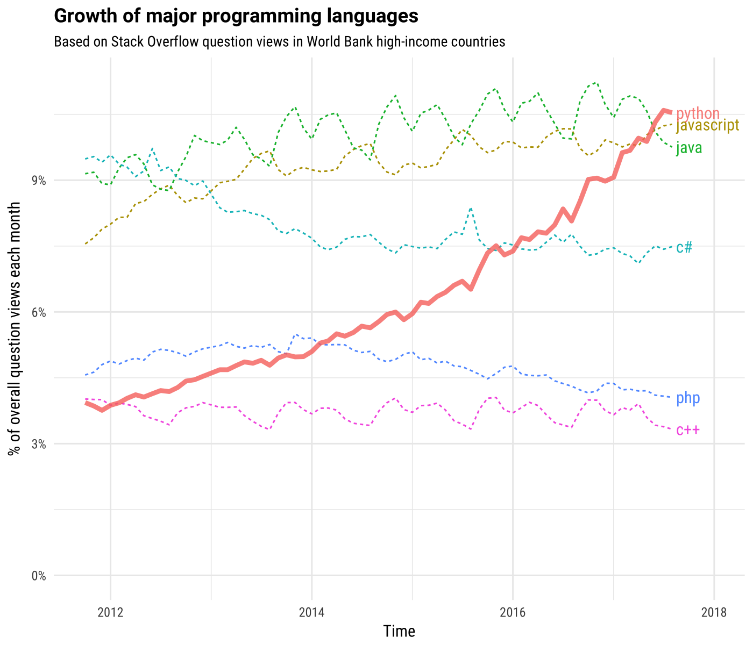
Demand for Python
PYPL Most Popular Programming Language
Source: StackOverflow

Slide 7
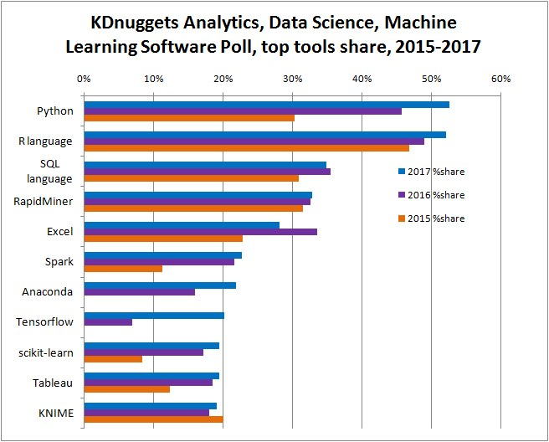
Top Data Science Tools

Slide 8
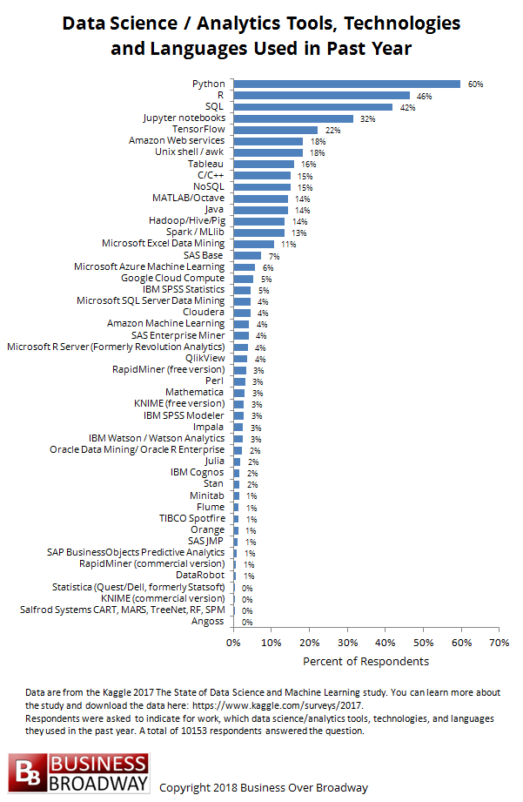

Slide 9
Python Applications
1. Data Science
2. Web Applications
3. Gaming
4. Education
5. Software development
6. Business Applications

Slide 10
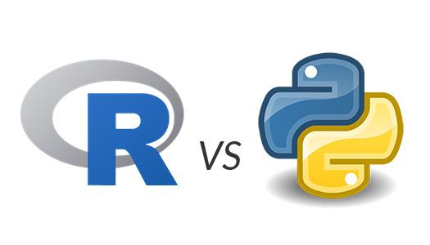
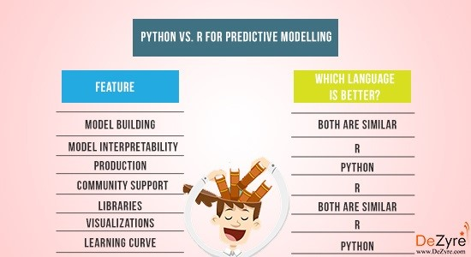
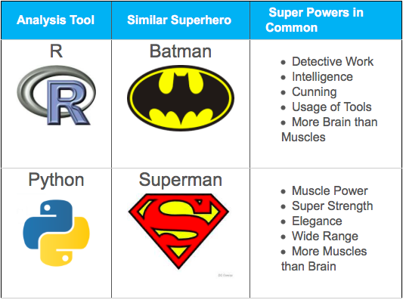
Ucanalytics.com
R is good for ad hoc analysis and exploring datasets, while Python is better for data manipulation and repeated tasks, – Quartz.com Former Data Editor Chris Groskopf
https://www.orison.biz/blogs/ch3ckmat3/2015/06/r-vs-python-for-data-science/

Slide 11
Python pros/cons
Pros | Cons
Readability, simplicity, learning curve is easy. Easy to code and debug. Less time coding and more time playing. | Number of packages.
General Purpose Programming Language. Production ready language. | Visualization Capabilities
Typically preferred by programmers and developers. | Slower
Great community support.
Open-Source! Free! ☺
Source: datacamp
Notes:
Python typically used when data analysis tasks need to be integrated with web applications.

Slide 12

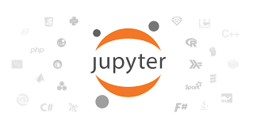

Tools to learn Python
Jupyter (Ipython) Notebook
IPython provides a rich architecture for interactive computing with:
A web application that allows you to create and share documents that contains live code, equations, visualizations and explanatory text.
Spyder is an open source cross-platform integrated development environment (IDE) for scientific programming in the Python language

Slide 13
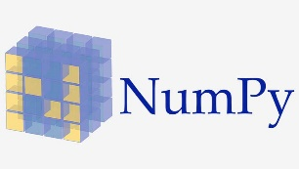
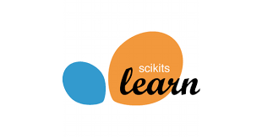

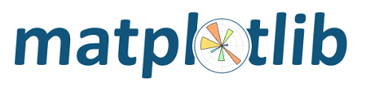
Design of Python
Core Python
String, List, Tuple, Dictionary, Set
Conditionals & Loops
Functions
Several additional modules that can be imported for more functionalities
Numpy
pandas
Sckit-learn
matplotlib
Seaborn

Slide 14
Words of Wisdom
Being an effective practitioner of data science is less about memorizing the tool or command you should use for every possible situation and more about learning to effectively find the information you don’t know…
Practice is the key for learning any programming language. It builds muscle memory.
One can spend an entire lifetime learning all the intricacies of Python and details of programming. But this is not very productive. Better to first write code that works. Improvements and efficiencies can come later.

